Slide 1
Presentation ON
Find The Pass Rate of HSC Exam of 2010 Using Lagrange Interpolation Formula

Slide 2
Presented to: Ayesha Siddika Assistant Professor & Co-ordinator Department of CSE
Presented by: Md Pias Hossain- 163432563
Md Rasel Hossain -163432521

Slide 3
Welcome to Our Presentation

Slide 4
Introduction
Road accidents have become common affairs nowadays in our country. It occurs frequently in any part of our country. Everyday we find the news of road accidents in the newspaper. Road accidents cause a great loss to the people.
Several reasons are working behind these road accidents. The drivers of the vehicles often do not care the traffic rules. They drive according to their own will. The drivers also try to overtake other vehicles. As a result, accidents occur. Sometimes, unfit vehicles are taken to the roads. These unfit vehicles cause road accidents. The roads and highways of our country are not wide enough. Most of them are narrow. This is another reason for causing road-accidents.

Slide 5


Slide 6
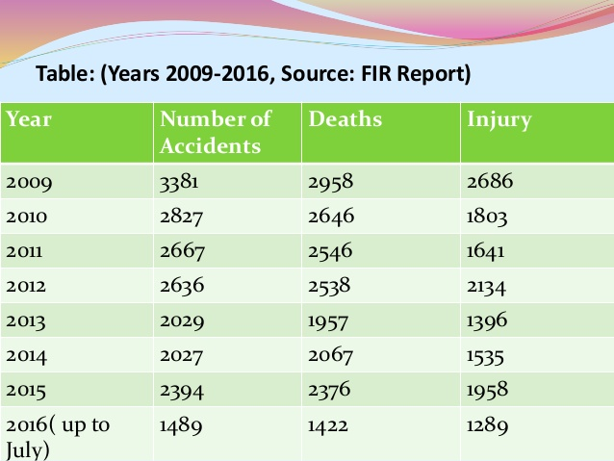
Here we represent a data table of road accident in Bangladesh, we collect it from FIR report 2016 Traffic road accident in Bangladesh

Slide 7
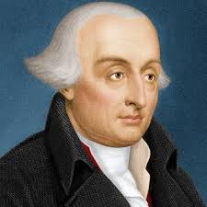
About Joseph-Louis Lagrange
Joseph Louis Lagrange (1736 -1813) From `A Short Account of the History of Mathematics' (4th edition,1908) by W. W. Rouse Ball. Joseph Louis Lagrange, the greatest mathematician of the eighteenth century, was born at Turin on January 25, 1736, and died at Paris on April 10, 1813.

Slide 8
Lagrange interpolation:
Lagrange polynomials are used for polynomial interpolation.For a given set of distinct points xj and numbers yj.
Lagrange’s interpolation is also an Nth degree polynomial approximation to f(x).

Slide 9
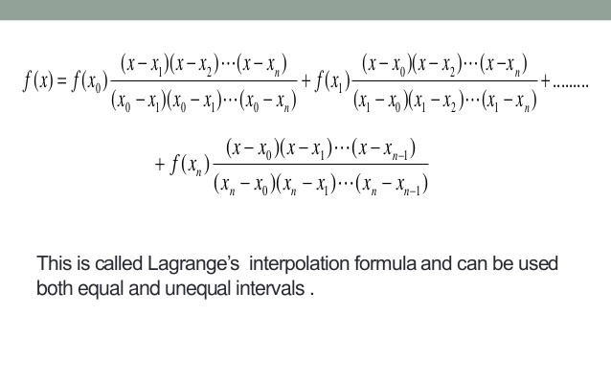
Formula:

Slide 10
Find the pass rate of HSC Exam of 2010 from given table, using Lagrange interpolation formula.
Year | 2008 | 2011 | 2013 | 2016 | 2018
Pass rate | 76.19 | 75.08 | 74.30 | 74.70 | 66.64

Slide 11
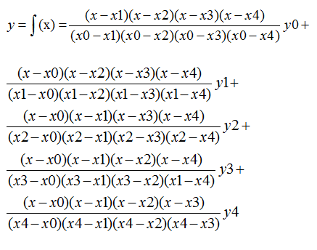
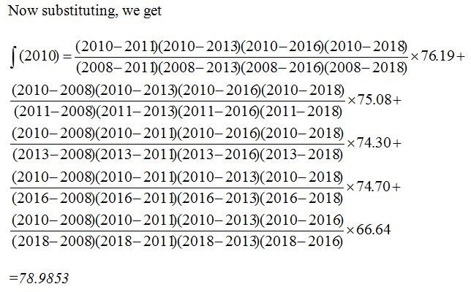
Solution:
We have
x0=2008, x1=2011, x2=2013, x3=2016,x4=2018 and
y0=76.19, y1=75.08, y2=74.30, y3 =74.70, y4=66.64, x=2010

Slide 12
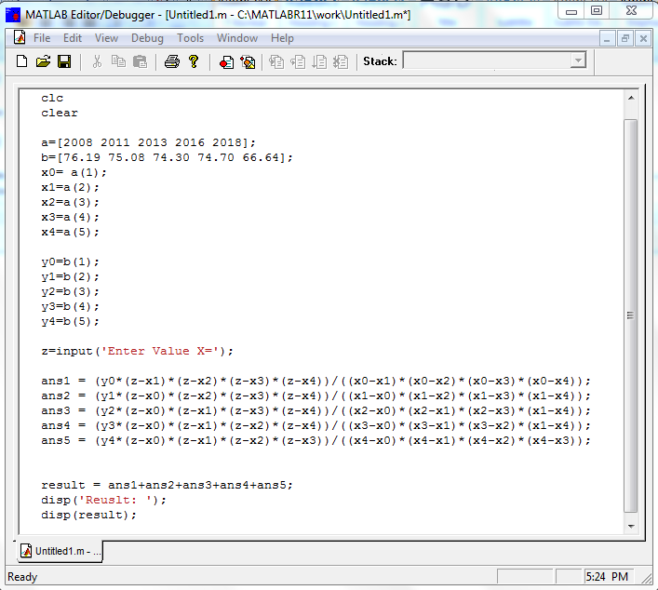
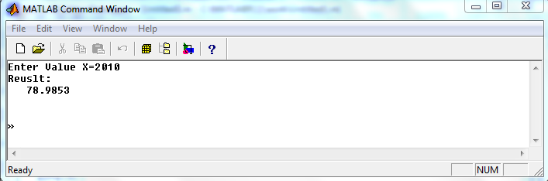
MATLAB Code:

Slide 13
Advantages: ▪ The formula is simple and easy to remember. ▪ There is no need to construct the divided difference table. ▪ The application of the formula is not speedy.
Disadvantages:
▪ There is always a chance to committing some error.
▪ The calculation provide no check whether the functional
▪ values used the taken correctly or not.

Slide 14
Conclusion:
Lagrange has a better performance at the boundaries
which makes it more convenient for real time applications.

Slide 15


